Slide 1

Uber rides analysis

Slide 2

Purpose of project
To understand how most riders use uber throughout weeks.
Uber’s ride price is not constant like public transport .
The factors that affected by the demand and supply of uber.
Is their correlation between the distance between price .

Slide 3

Cleaning and filtering the data
Drop empty rows
Convert epoch time to daytime
Filter the data since we are looking uber data only.

Slide 4
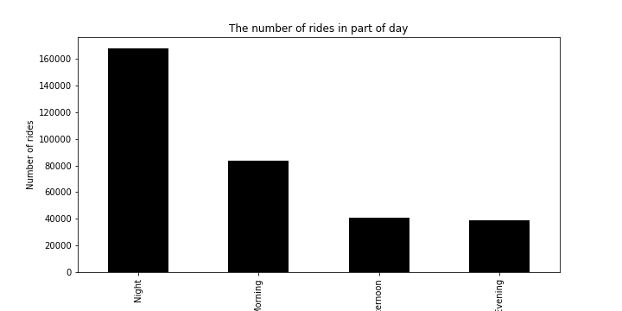
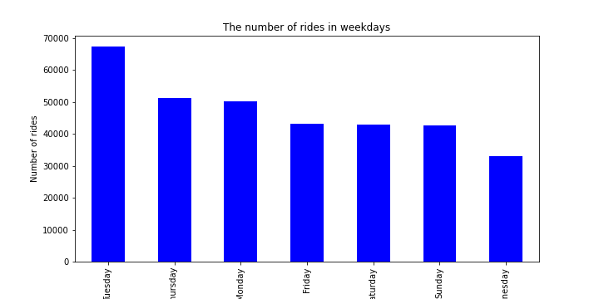
Which day has the most pickup?

Slide 5
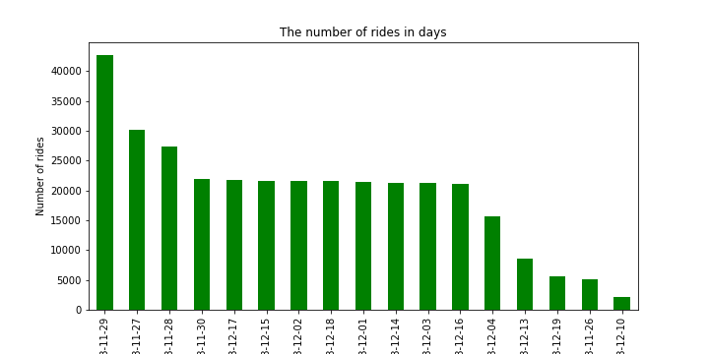
which date has the most pickup?

Slide 6
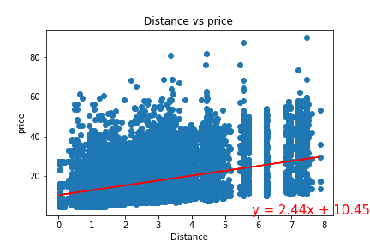
Linear regression

Slide 7

Limitation
Google Api’s
Data set.

